Slide 1
Big Data Architecture and Governance
Group Project | FAF Game Analysis
Sanika Saraff
Trupti Raut
Shiva Shankar Ananthula

Slide 2
Dataset Summary
Dataset Name : Forged Alliance Forever(FAF) Game Dataset
Kaggle Dataset Link : https://www.kaggle.com/code/yanivaknin/introducing-faf-datasets/data?scriptVersionId=100892524
FAF (Forged Alliance Forever) is a gaming community driven project designed to facilitate online play for the game Supreme Commander: Forged Alliance. It is being supported by various fan volunteers who maintain the community, add unofficial patches, maps, mods and release regular context for the FAF Supreme Commander.
FAF game has a scrapable API tracking every game ever played by a player, and a parseable binary replay of every command issued by each player in every game.
Our dataset is picked from Kaggle and it was published there by scraping the game data of around 10M FAF games about who played who, on which map, what’s the scoreboard etc.
There were 5 datasets related to FAF all of which were used for storing data in a central graph database for storing player, game, map, command statistics for analysis purposes.

Slide 3






Tools & Techniques Used

Slide 4
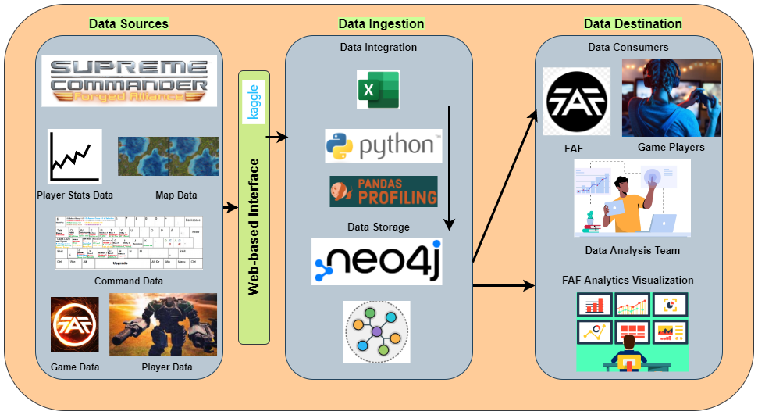
Vision Diagram

Slide 5
Data profiling DATA WRANGLING/CLEANING DATA LOADING

Slide 6
Data Profiling Instructions
Our first step towards understanding the datasets was data profiling which is the process of examining the data available from an existing information source and collecting statistics or informative summaries about that data.
We have profiled our datasets using Python, Jupyter Notebook and the detailed steps for various installations and running the code have been given in the user documentation
Download Python --> Install Anaconda --> Open Jupyter Notebook
Download the 5 datasets from this link
Run the Jupyter notebook Data_Profiling.ipynb
HTML file for the profiled datasets will be created for viewing data

Slide 7
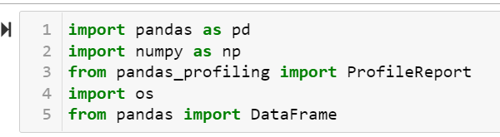
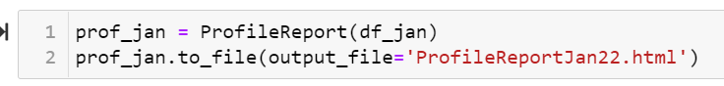
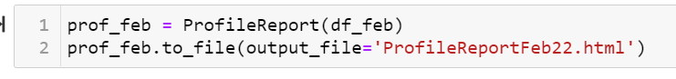
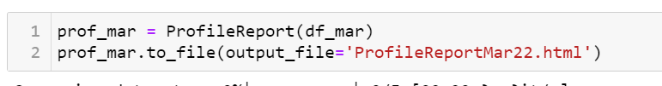
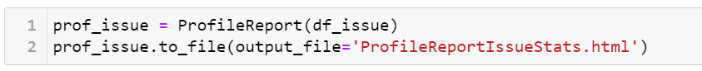
Data Profiling Script.

Slide 8
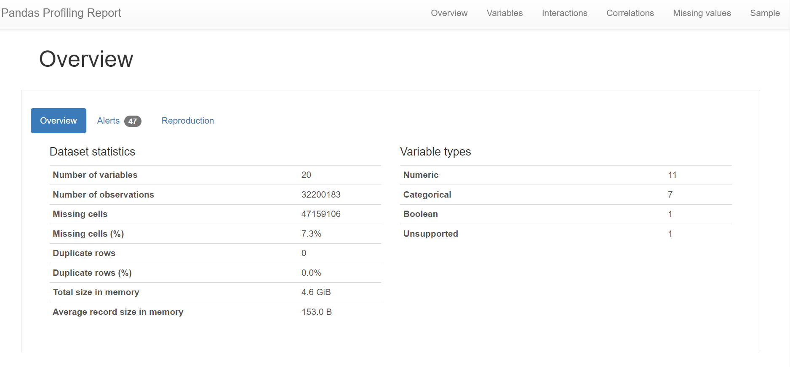
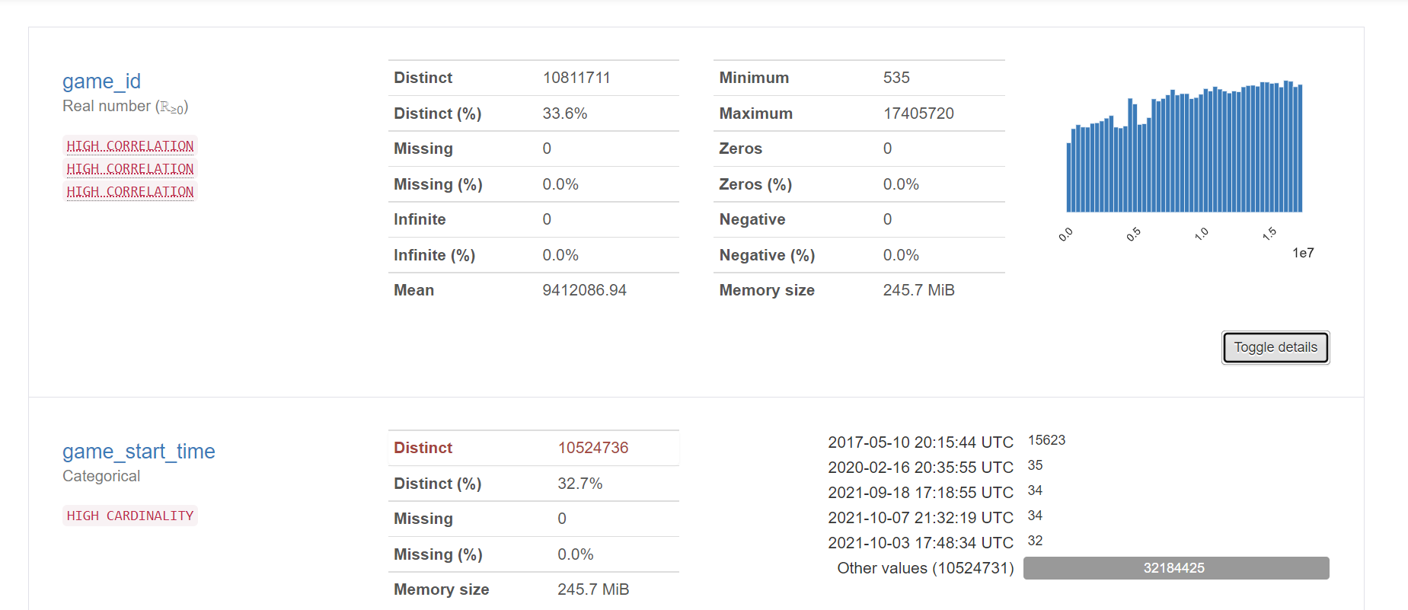
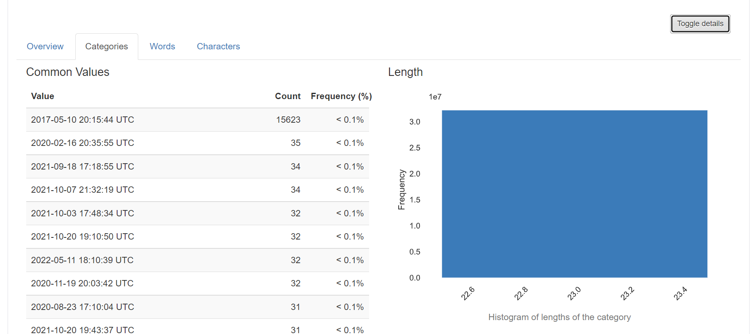
Profiling Output.

Slide 9
Data Wrangling/Cleaning Instructions.
After refering to the profiling files, we tried understanding the data and the fields available
Our next step was cleaning the datasets, getting them to usable formats before loading to Neo4j graph database and we will be using Jupyter notebook for the same. Detailed steps are in the user documentation
Open Jupyter notebook and run Data Wrangling and Cleaning.ipynb script
Once the script is finished running, issues_stats_clean.csv , janfebmar_combine_clean.csv , player_stats_clean.csv files will be created.
Use these new filtered datasets for database loading,visualization.

Slide 10
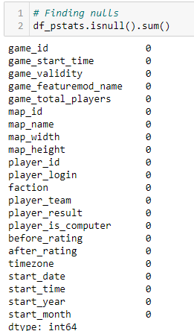
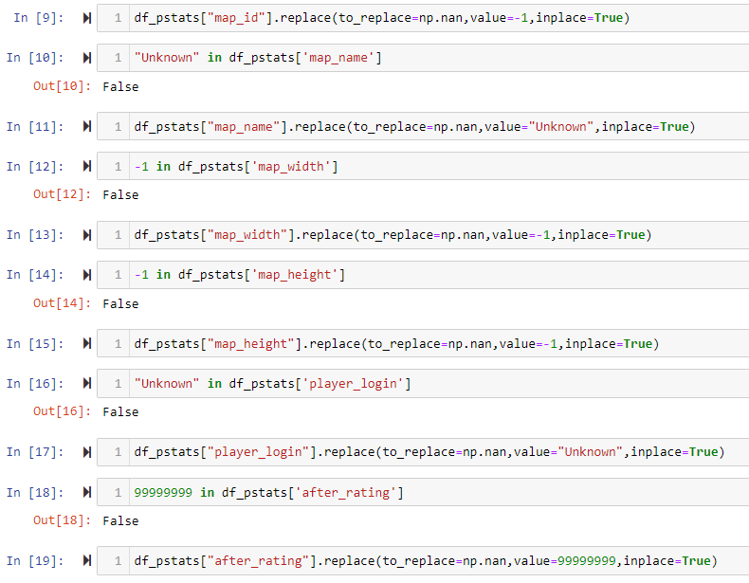
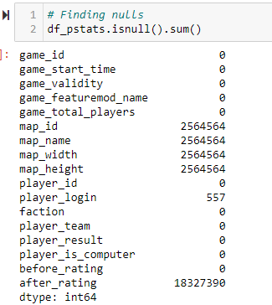
Data Cleansing/Wrangling.
First step was to find whether the datasets have any null values and their count to handle these. These nulls were handled by assigning a standard value decided by the team.

Slide 11
Data Cleansing/Wrangling.
Next, we renamed the columns in all the datasets to get a standard column name throughout datasets.
Columns which were not used for analysis were dropped.

Slide 12
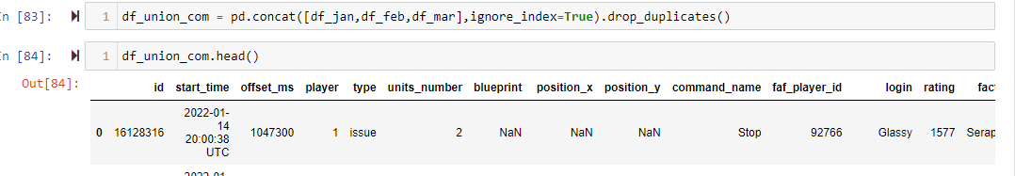
Data Cleansing/Wrangling.
3 datasets which had similar format with different start dates were combined into one dataframe. The combined records for these three datasets before loading matched the records after loading

Slide 13
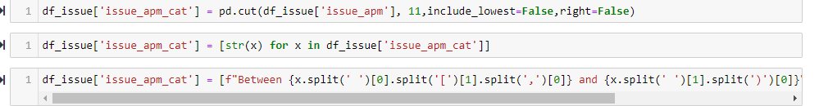
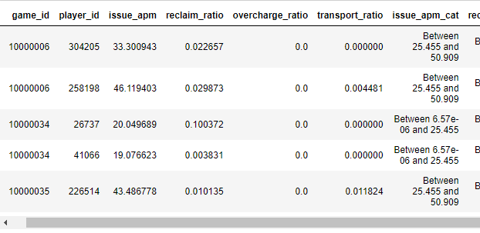
Data Cleansing/Wrangling.
IssueAPM column which had values from range 6.565920523 × 10-6 to 252 were divided equally into categories and a different categorical column for created for this field.

Slide 14
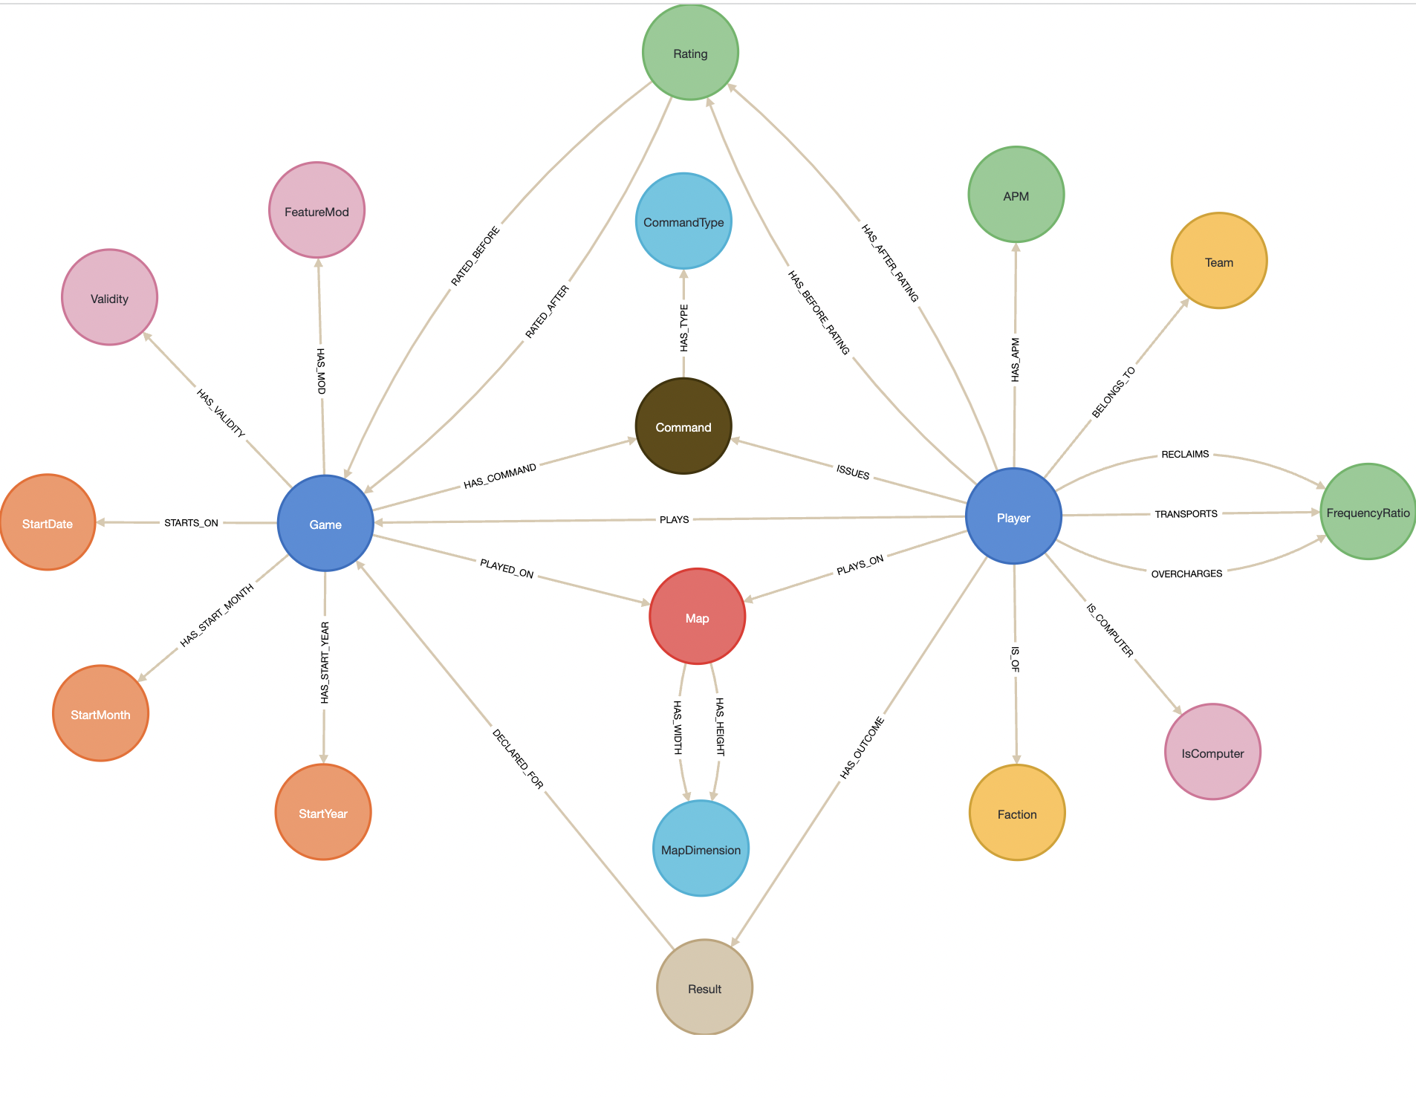
Graph Database Design:

Slide 15
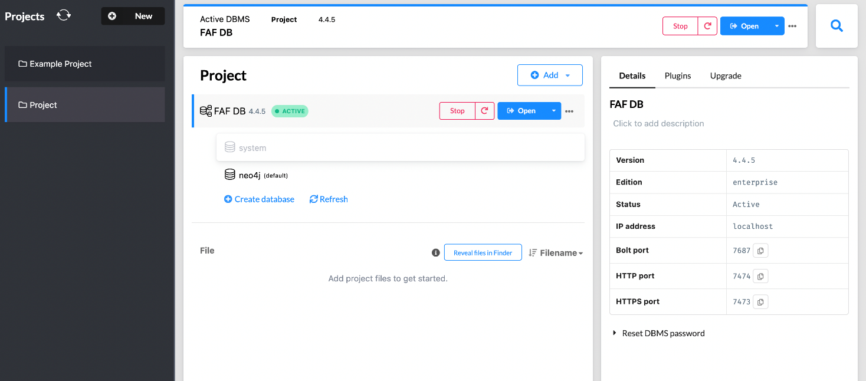
Data Loading in Neo4j
We used Neo4j for loading all the data from the cleaned datasets. Detailed steps are given in the user documentation.
Download and Install Neo4j Graph database
Create a new Database in Neo4j named FAF DB
Copy the cleaned csv files into the DBMS import folder
Start the database and open the database.
Use the ‘Cypher queries.txt’ data loading script for loading data

Slide 16
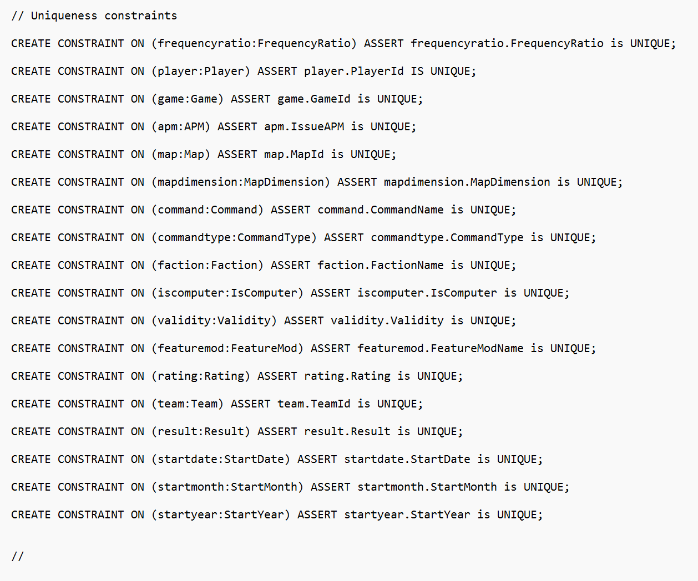
Data Loading in Neo4j
Constraints creation

Slide 17
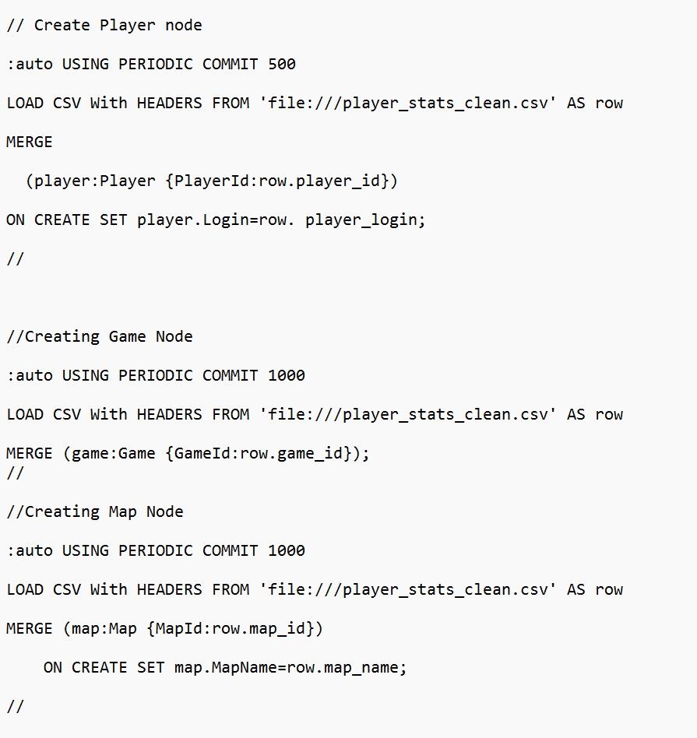
Data Loading in Neo4j
Node creation

Slide 18
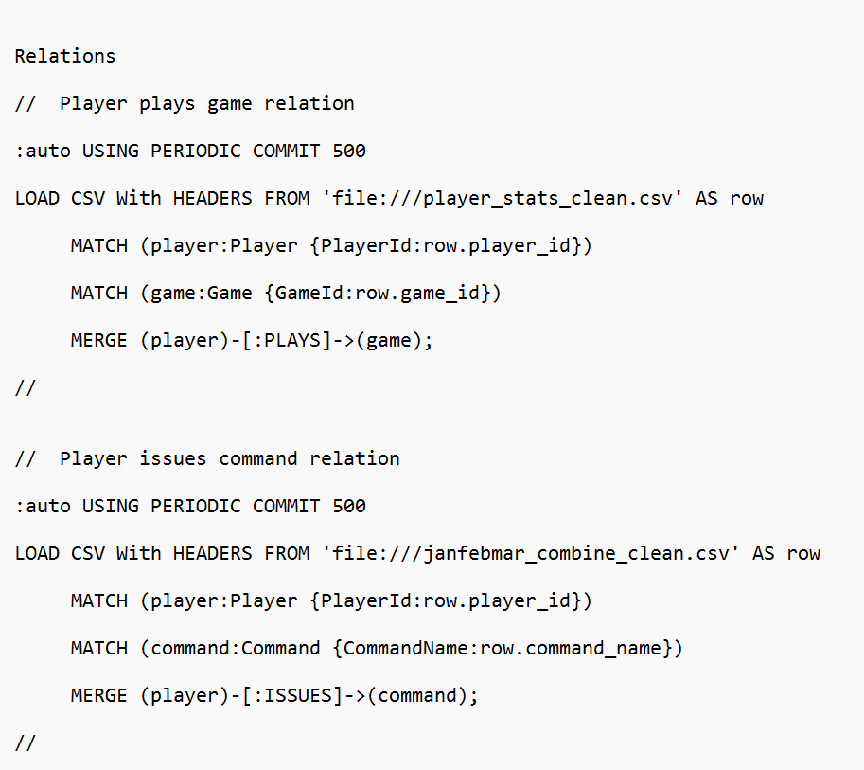
Data Loading in Neo4j
Relationship creation

Slide 19
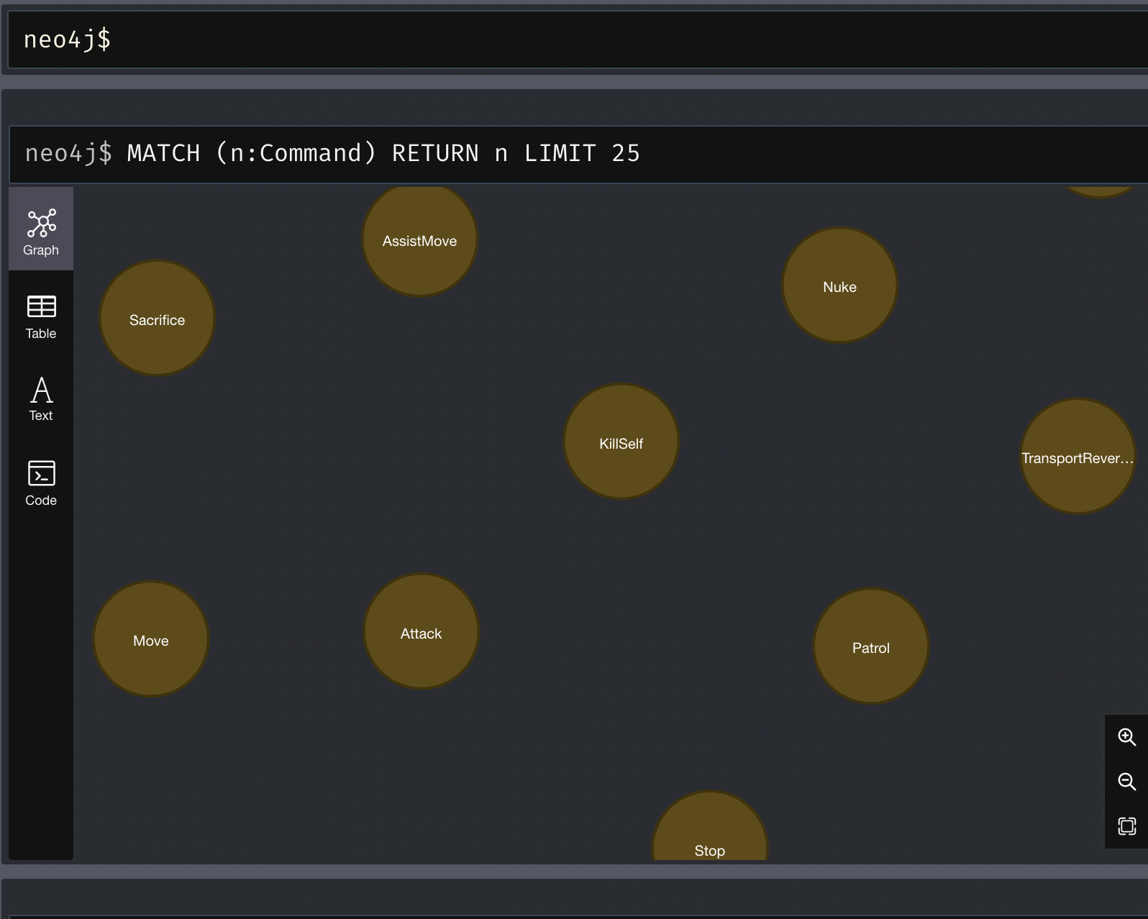
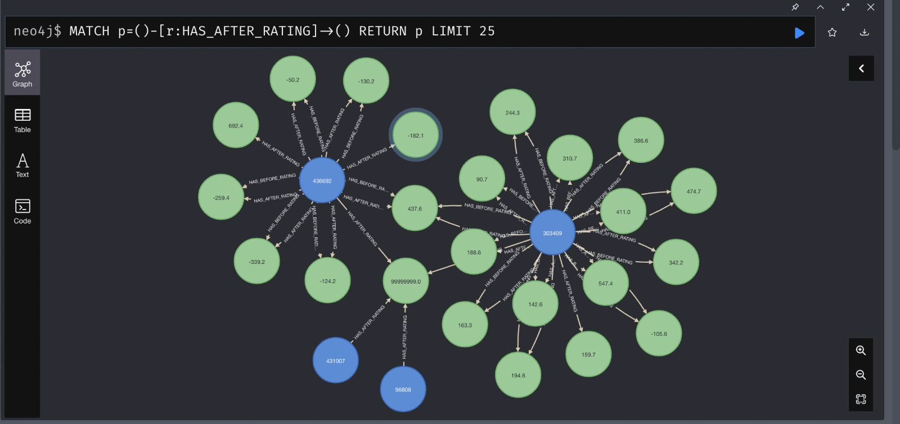
Neo4j Screenshots after Loading

Slide 20
QA/TESTING

Slide 21
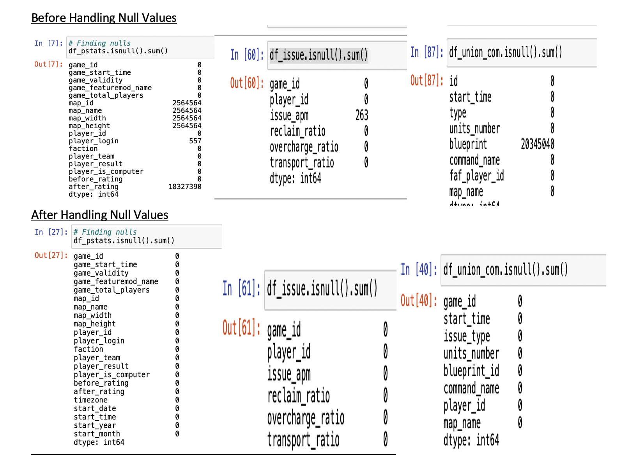
Null Value Checks

Slide 22
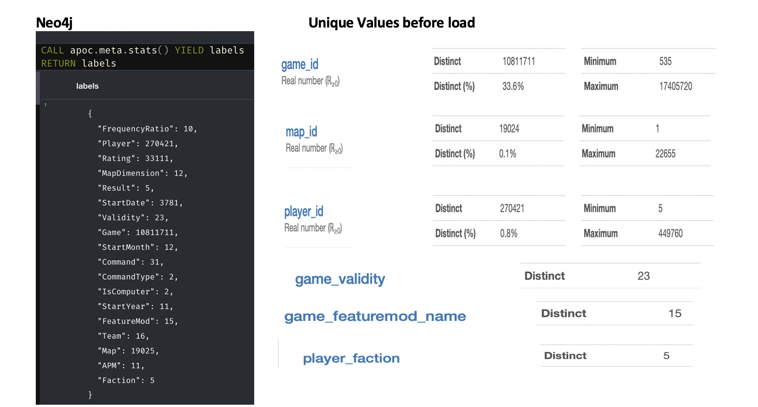
Unique Counts for Nodes

Slide 23
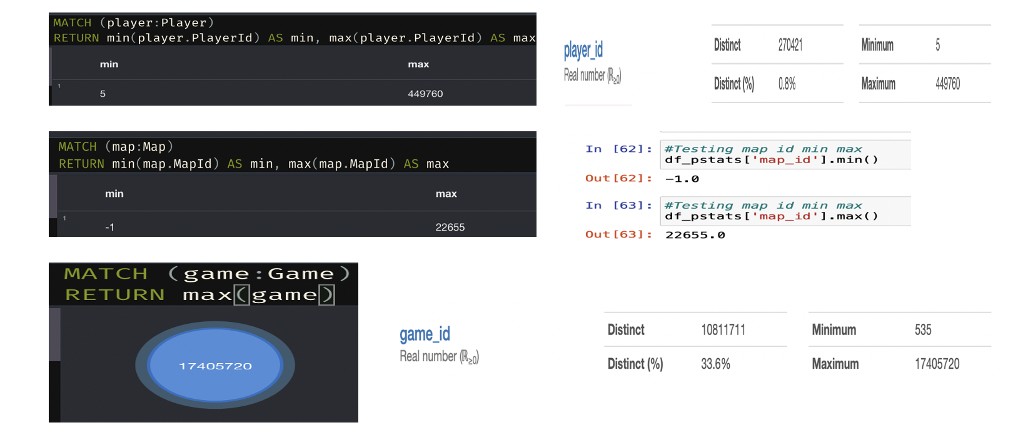
Minimum and Maximum Counts Check

Slide 24
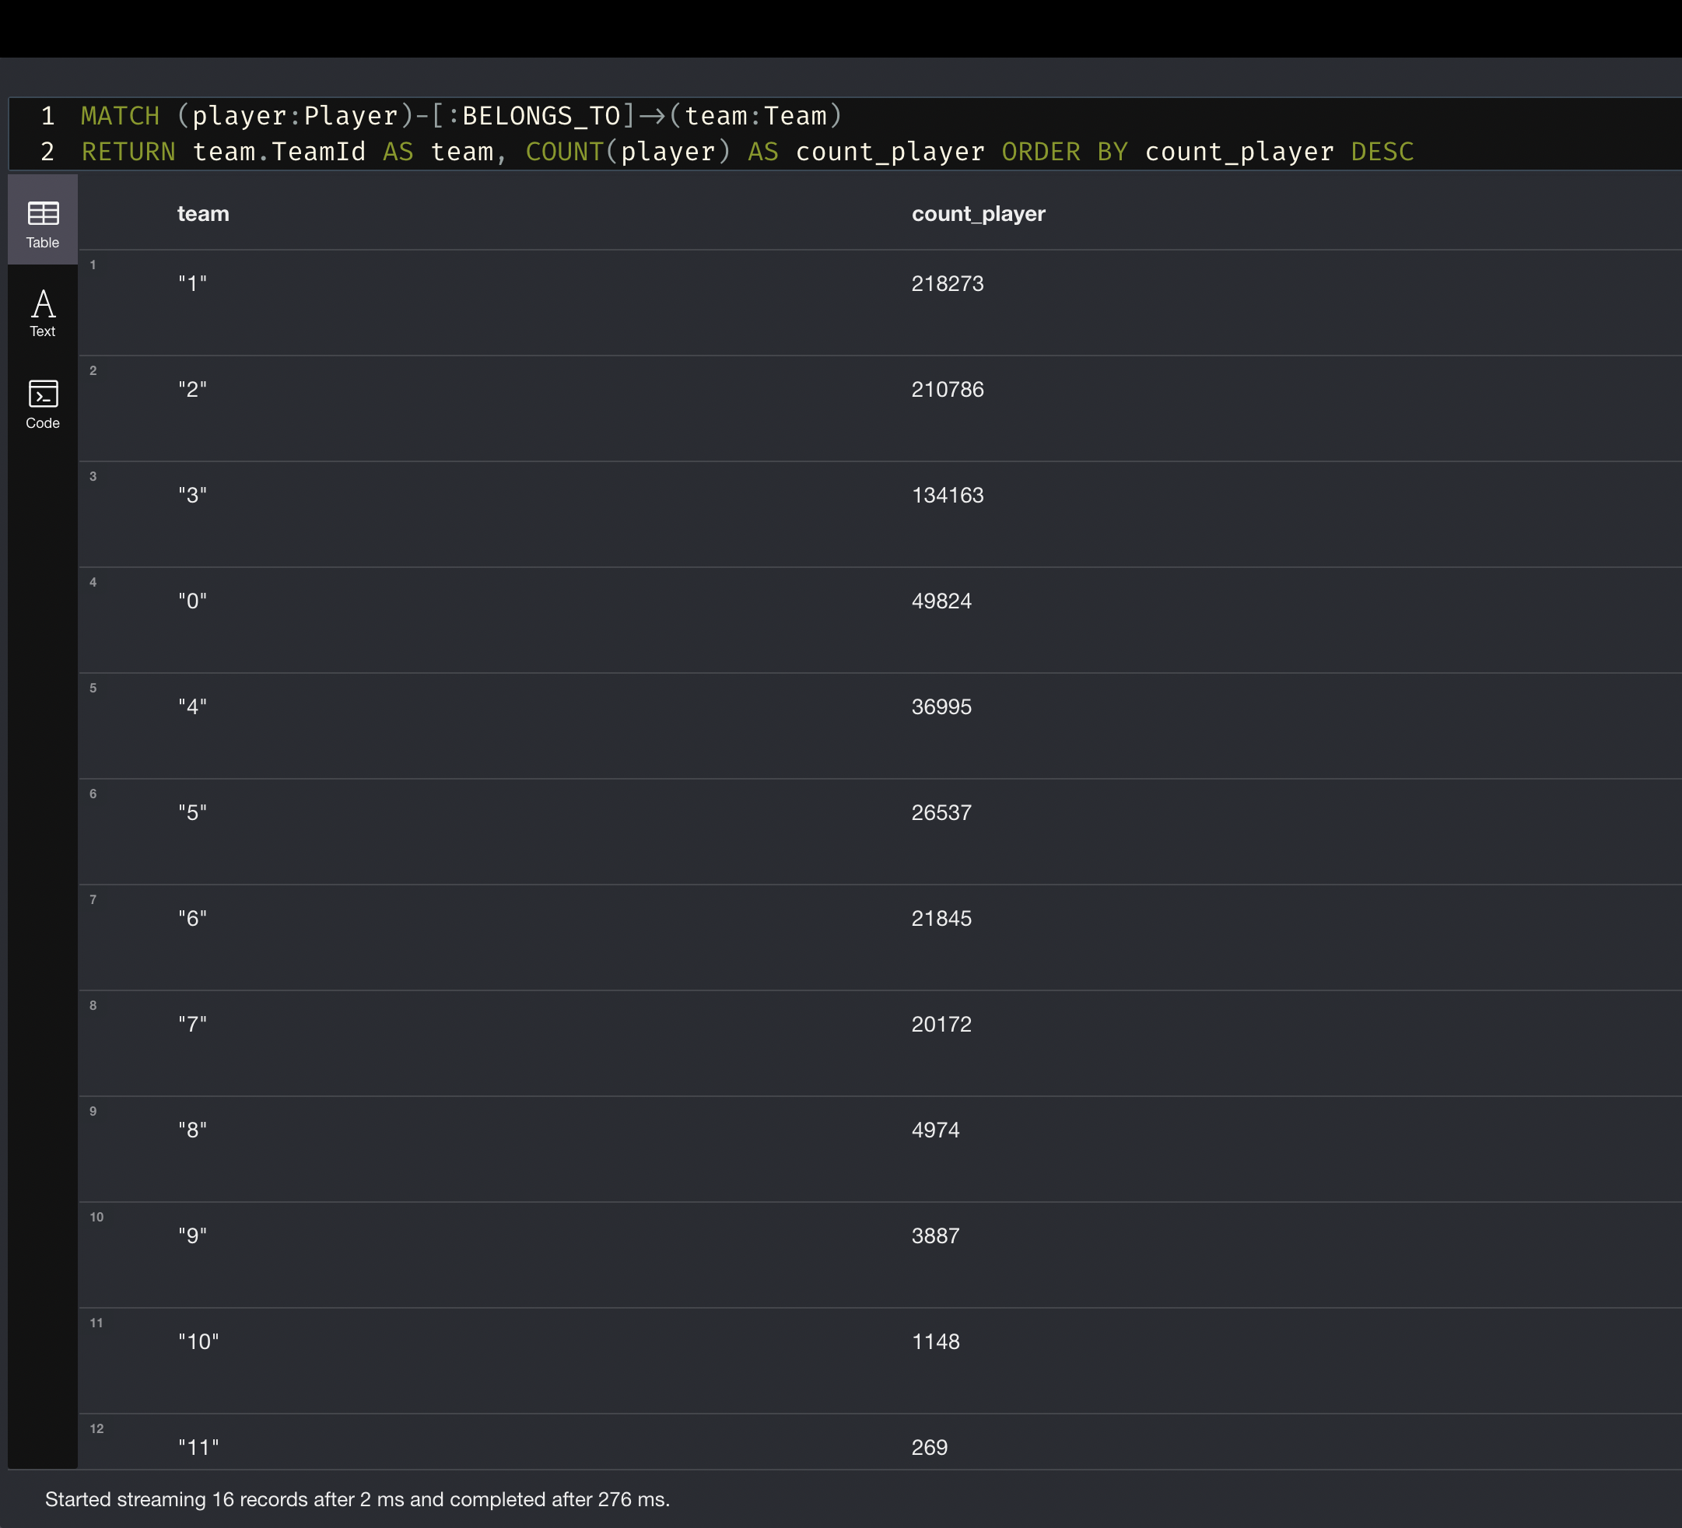
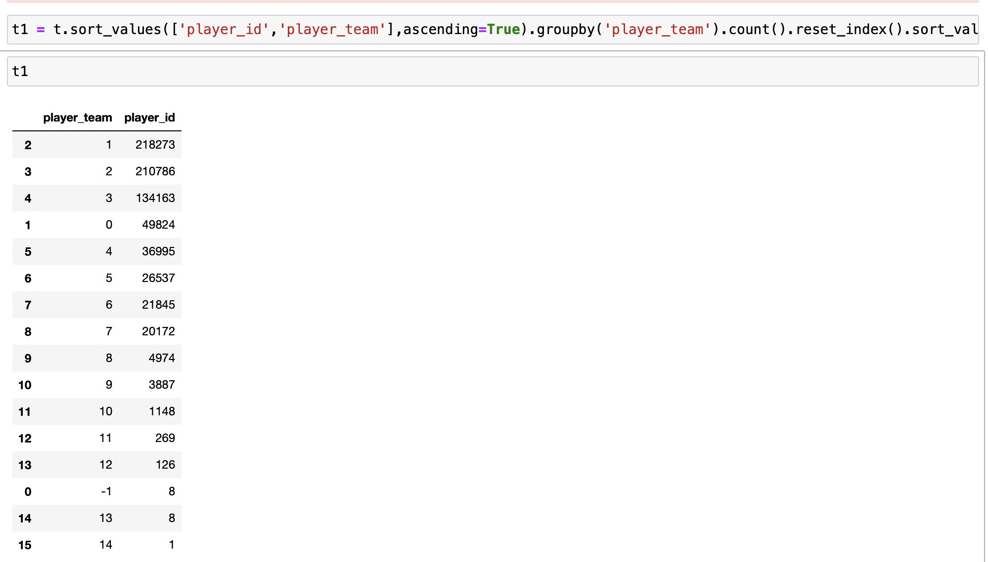
Neo4j Tests: Team - Player count test

Slide 25
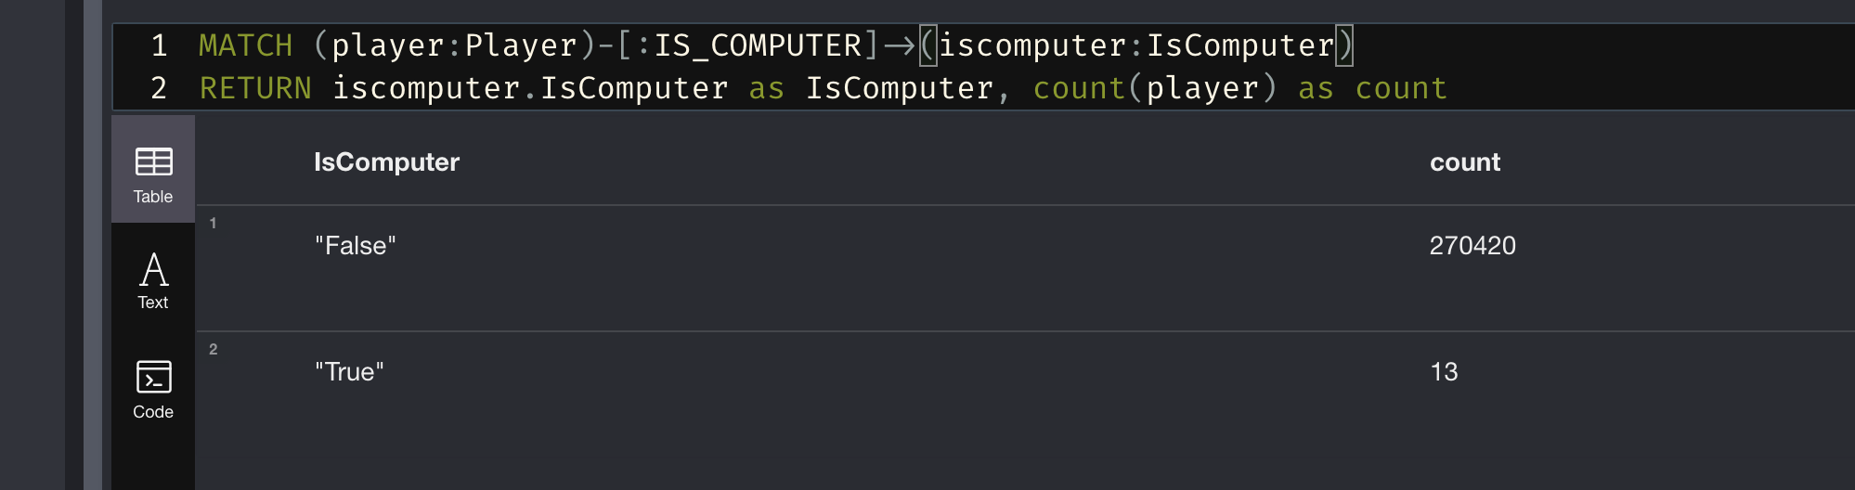
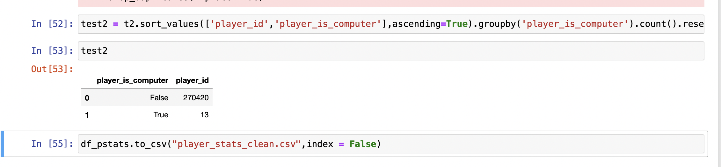
Neo4j Tests: Player - IsComputer Test

Slide 26
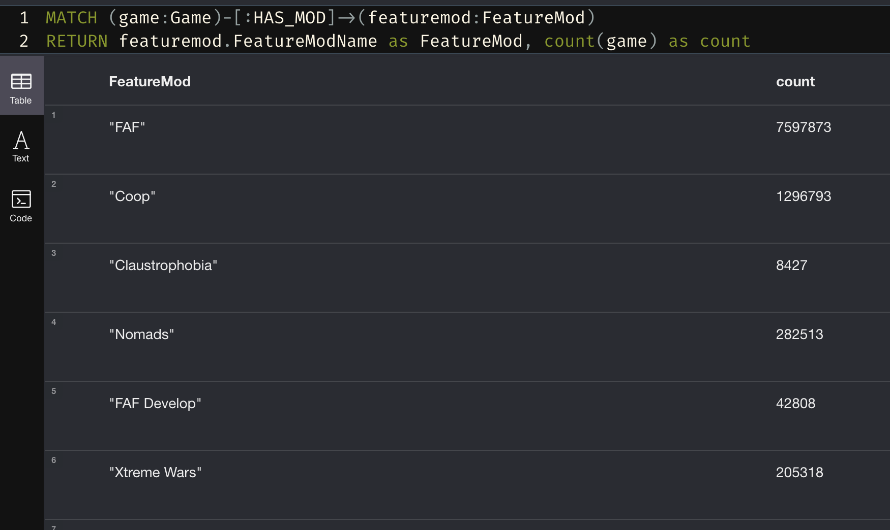
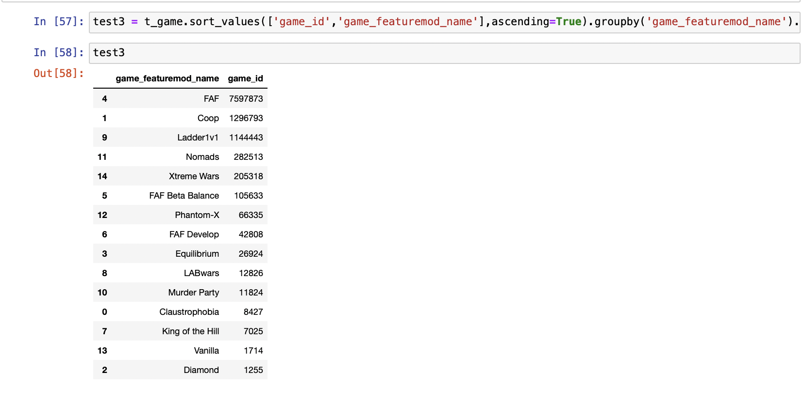
Neo4j Tests: Game – FeatureMod Test

Slide 27
metadata

Slide 28
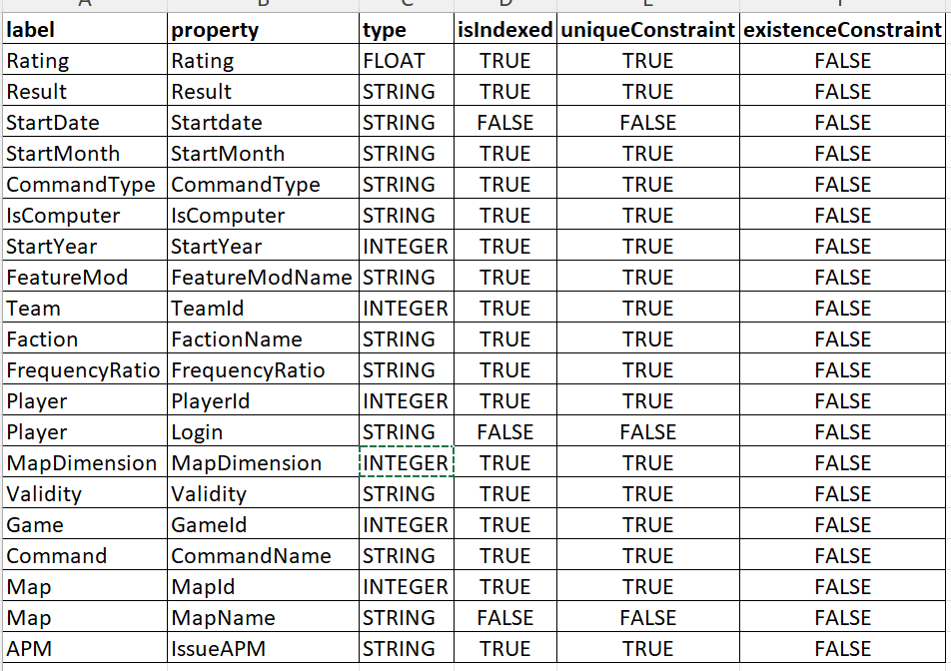
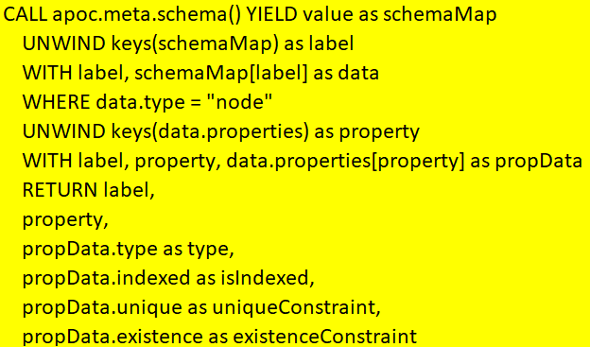
Technical Metadata

Slide 29
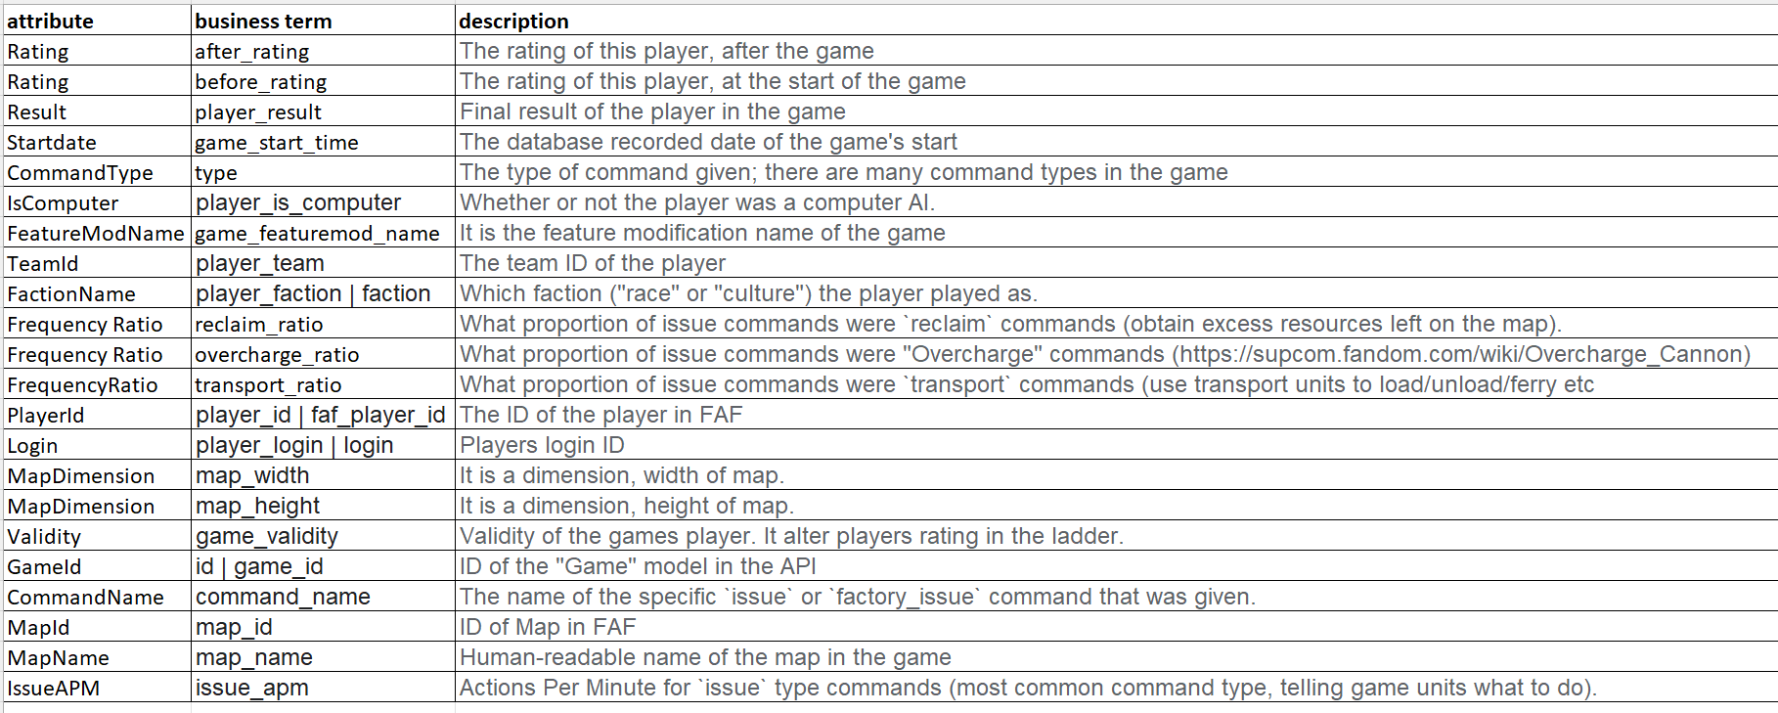
Business Metadata

Slide 30
DATA VISUALIZATION

Slide 31
USE CASES
Who would use this dashboard and how do they benefit from your dashboard?
Members of the FAF Game community would need to analyze the data being generated to determine various KPI’s for them to develop new enhancements to the multiplayer game.
Players of the FAF game who follow this community can also use these dashboards to compare their game with other top players and improve their gameplay

Slide 32
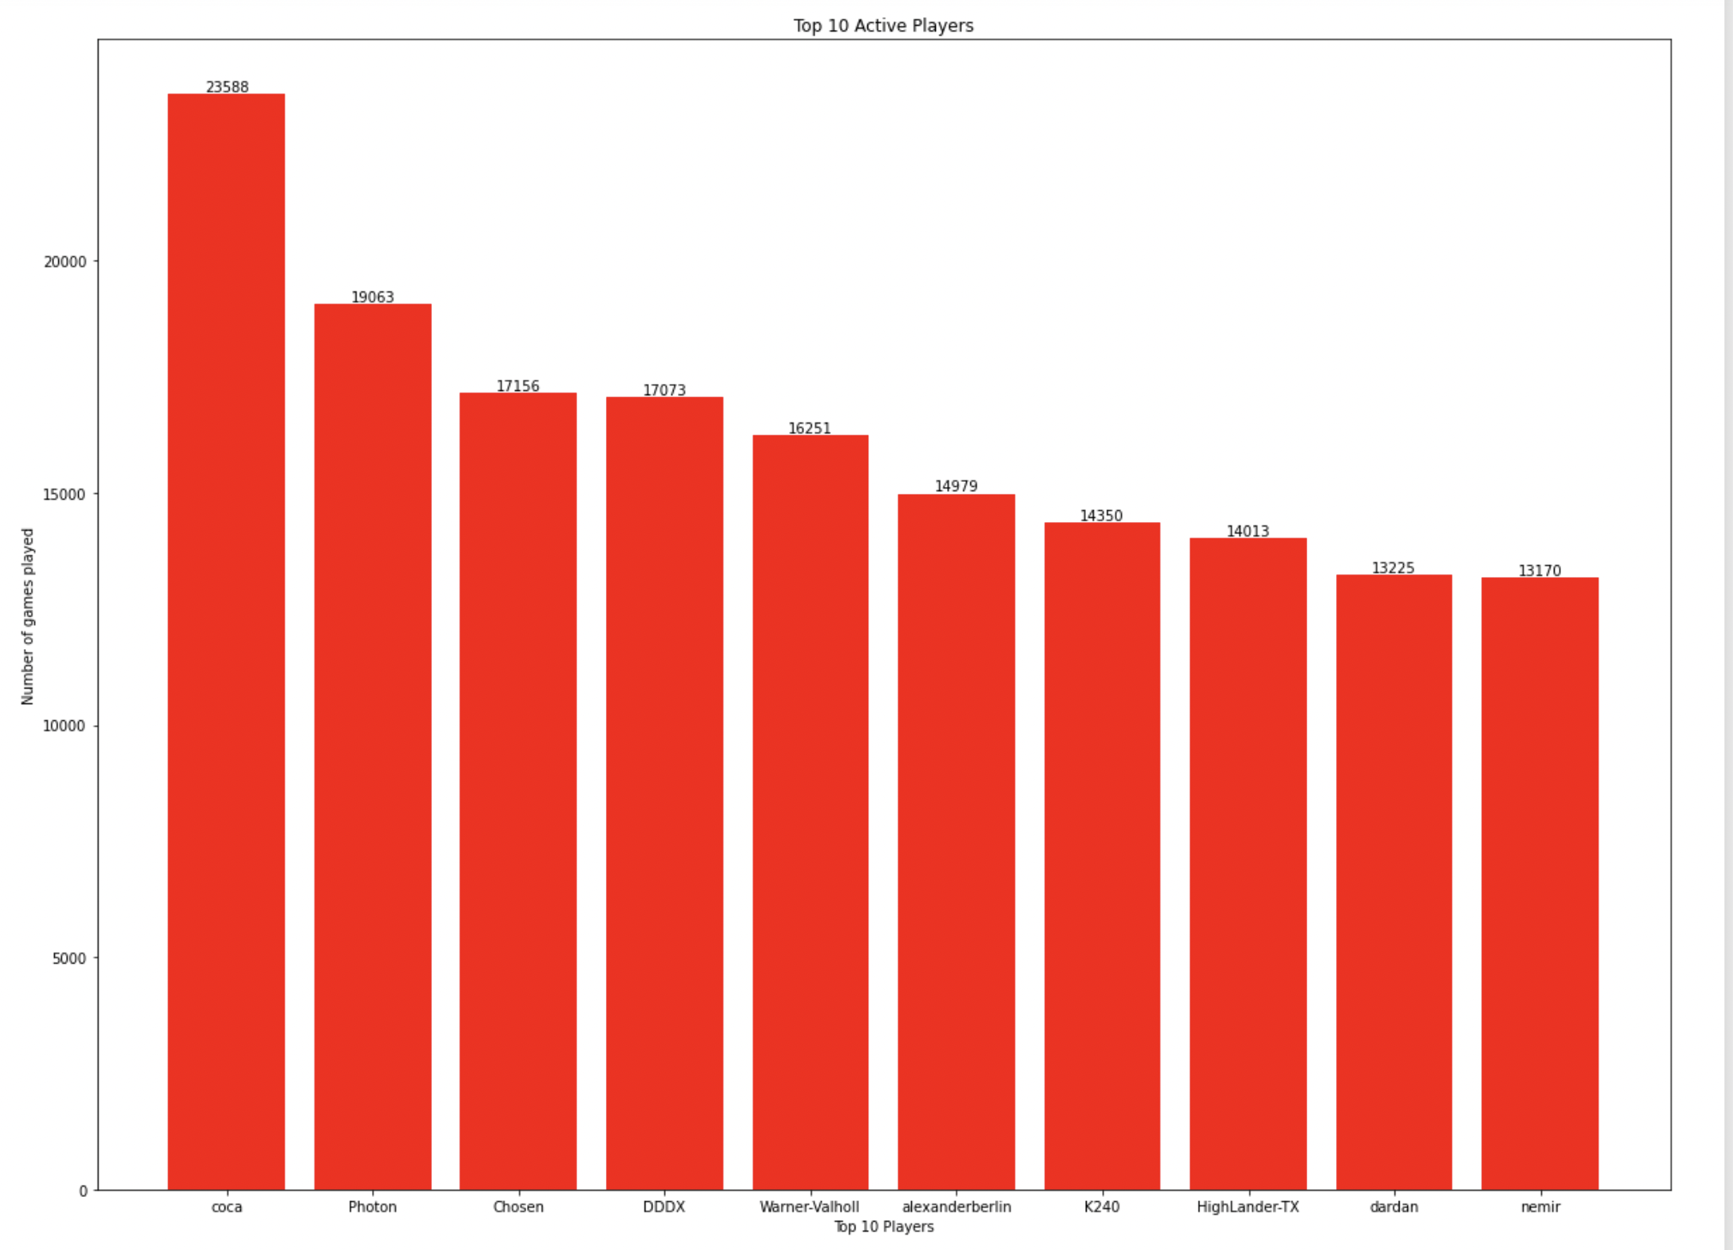
Players With Highest Number of Games
This bar graph gives the users an idea of who played the highest number of FAF games till date. It depicts the players who are most actively playing the game and will be useful for the other players who wish to improve their game as they can investigate the statistics of these active players and understand their gameplay. This graph can also be useful for the community members at FAF to determine who are the highly engaged players and further they can analyze what type of games/maps/commands are being used by them to enhance the future modifications for games based on these. We can see that the player with login name ‘coca’ has played highest number of games which is 23,588 till date which is June 2022.

Slide 33
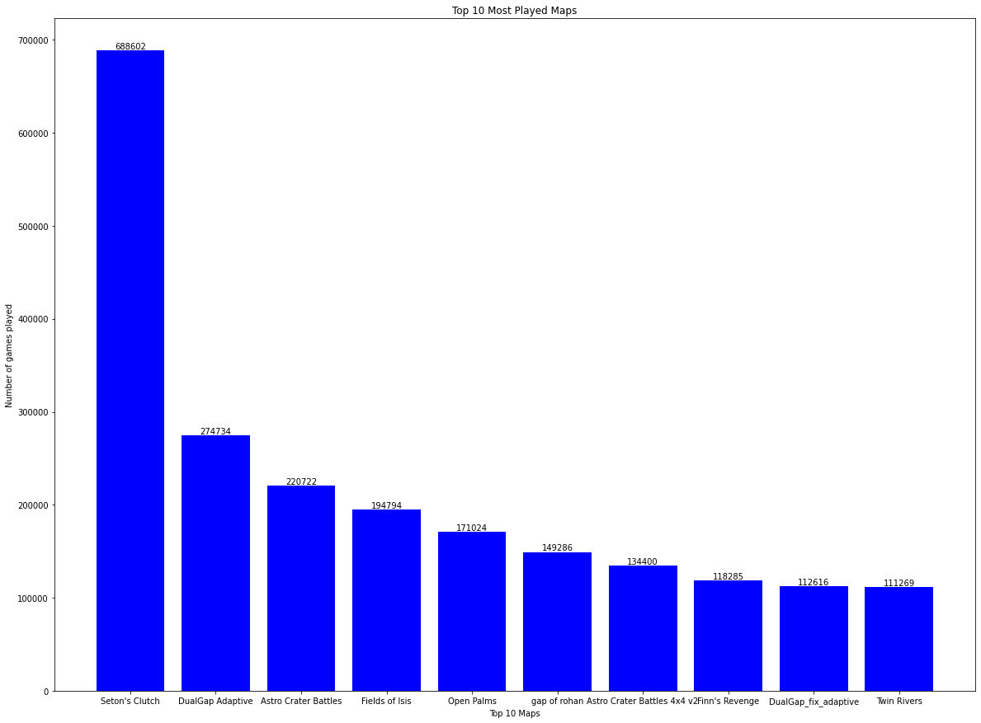
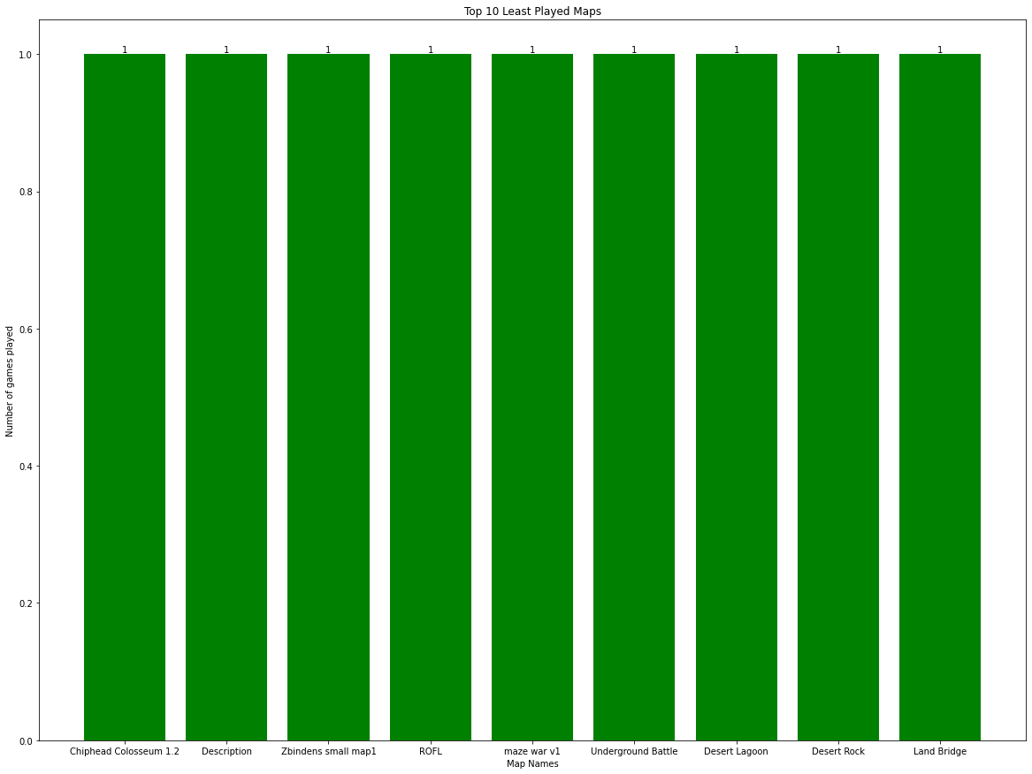
Top Most and Least Played Maps

Slide 34
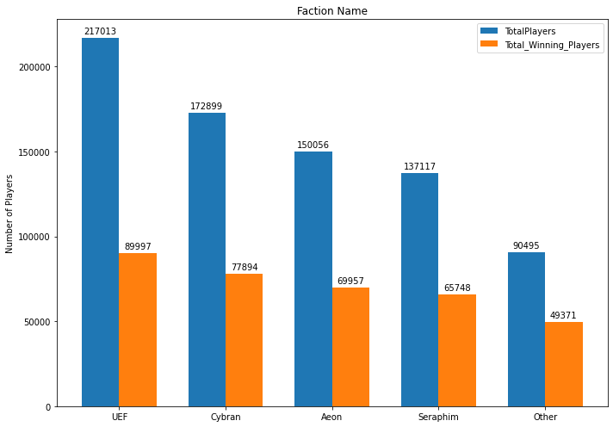
Player Statistics by Faction
This bar graph helps us understand how many players played as various factions out of the total available factions. Further it also tells us how many players out of the total won the game by playing as that faction. This information will be useful for players to understand what number of players were using a particular faction and how many out of them won the game to choose their faction before playing. This data can also be used by the community members to decide which faction is a winning faction and what utilities need to be added to the underperforming factions to improve the game and increase the difficulty.

Slide 35
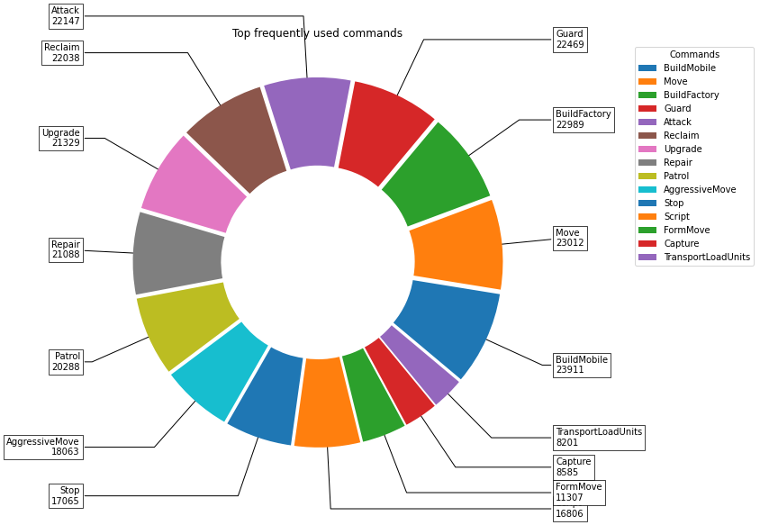
Most Frequently Used Commands

Slide 36
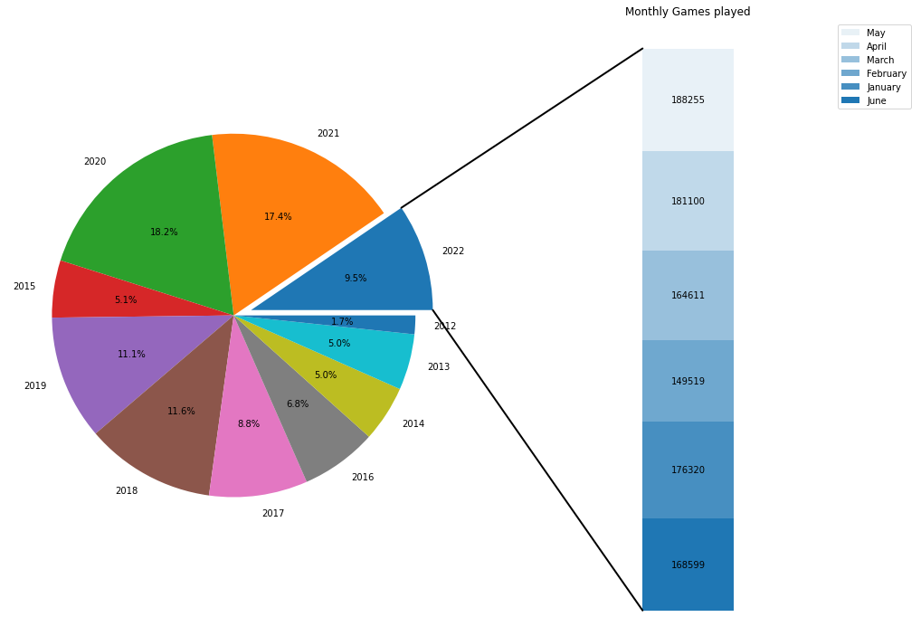
Games Statistics by Month and Year
This pie chart shows what percent of the total games played till date was played in every year starting 2012 to 2022. The bar on the right depicts the number of games played in every month of 2022. This graph is useful for the community members to find in which year more games were played and shows the distribution of games played by months for the most recent year. This can be used in deciding how the game is performing overall year after year and which year had the maximum games played. Further, this information can be used to find out what modifications were prevalent in that year which led to more number of players playing the game.

Slide 37
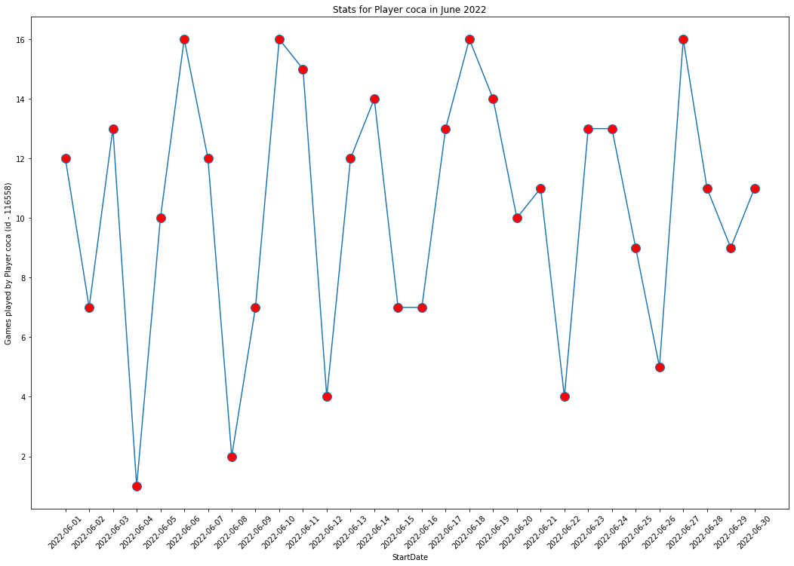
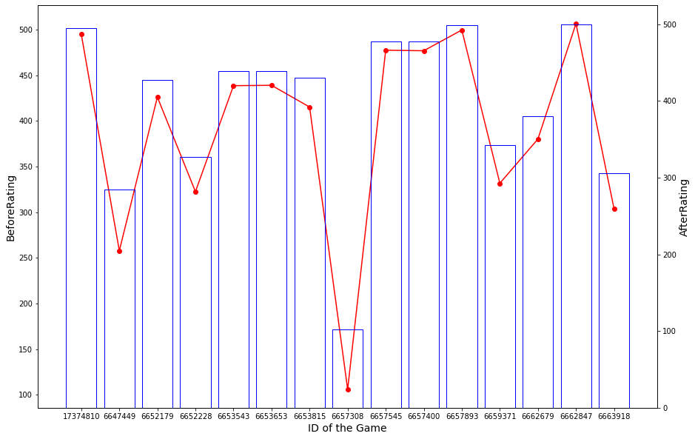
Statistics of Player with Login ID Coca

Slide 38
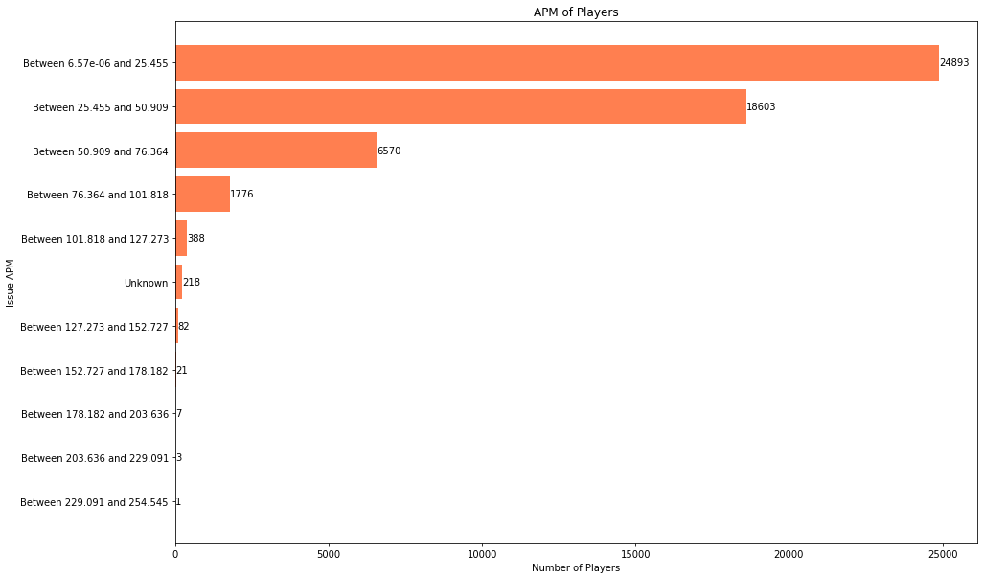
Actions per Minute by Players
This horizontal bar diagram is for the command type name issue and shows the actions taken by total players per minute. This has been divided into categories and we can see that most players have an APM between 0 to 25. This data can be useful for the players to determine how many issue command actions are being done by other players and how much they need to improve on their speed of using this command to win.

Slide 39
Data Challenges
Challenges | Mitigation
1. Issue with profiling on the local server due to huge size of the dataset. | Used different machine with a high configuration to perform profiling.
2.Lack of knowledge about FAF game | Research thoroughly about the FAF game commands and rules.
3. Ratio related columns are highly skewed when observing distribution. | Classifying data into categories.
4. Incorrect datatypes in the neo4j while loading leading incorrect minimum and maximum values of the fields. | Corrected the datatypes in the database after loading.
5. Faced Heap Space issue exception whiling uploading the data related to the game node due to the data being large. | Updated the neo4j memory configuration.
Difficulty understanding data context
Reference to Astronomy Data websites and Small-Body Database published by NASA
Lack of knowledge of scientific terms
NASA JSPL web page reference metadata used
Some columns containing 98% of null values
Accessed the value and dropped unwanted columns, alter values to be used for analysis
Many columns highly skewed when observing distribution
Classifying data into categories
Pinpointing data analysis focus for visualization
Selecting higher weightage metrics like NEO, PHA
Lack of qualitative data beyond asteroid id’s/names and general class
Create association by relations between data attributes

Slide 40
Risks and Issues
Type | Description | Mitigation
Risk | Less knowledge of cypher (Neo 4J) | Watched and learnt through online tutorials
Risk | Lack of Knowledge about the FAF game among team members which could lead to incorrect analysis | Performed prior research and understanding of FAF game dataset.
Issue | Metadata seemed to be vague | Researched and tried to make sense of the data and relation between entities
Issue | Issue profiling data | Tried loading data on a better and high- performance system

Slide 41
Velero Screenshots

Slide 42
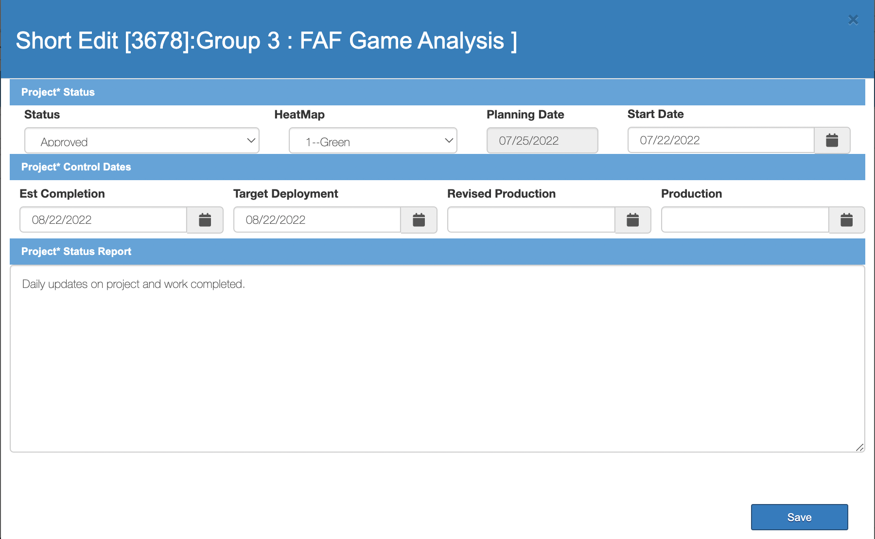
Short Form

Slide 43
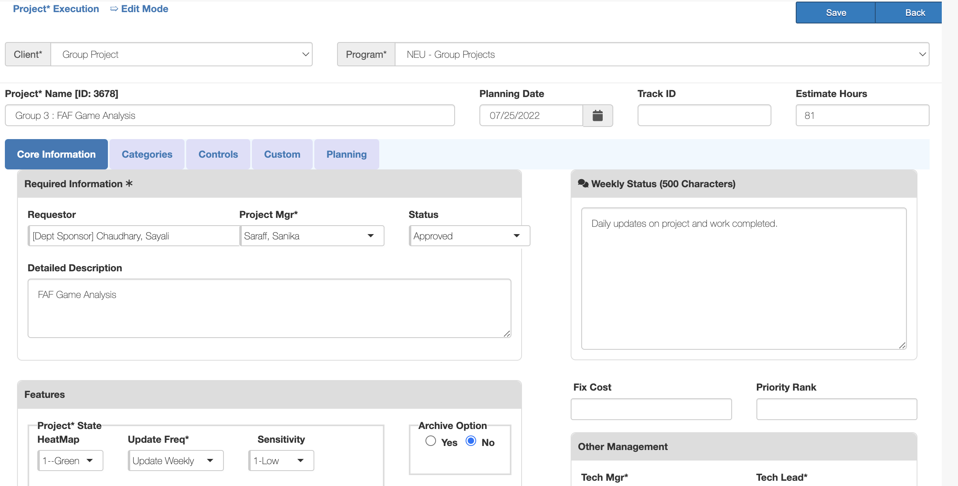
Long Form

Slide 44
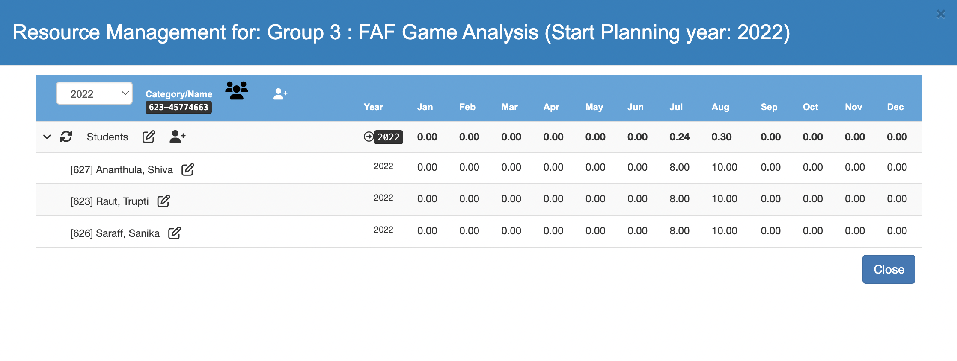
Resource Management

Slide 45
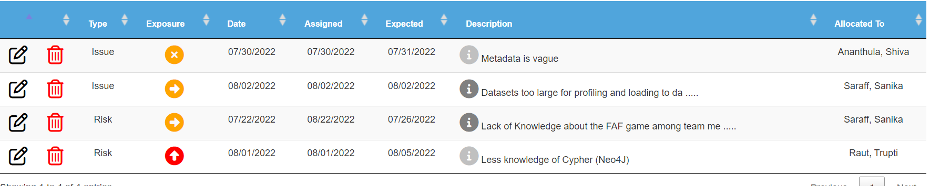
Risks and Issues

Slide 46
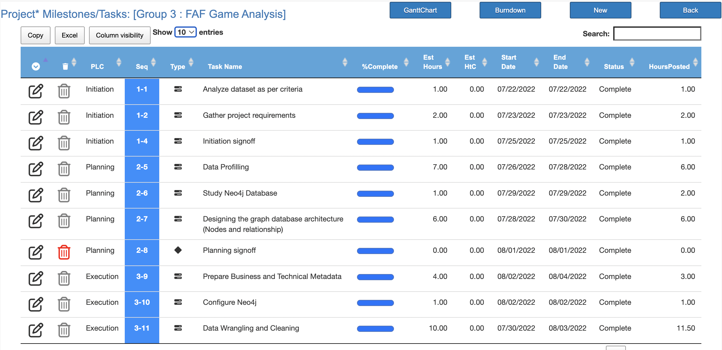
Tasks/Milestones

Slide 47
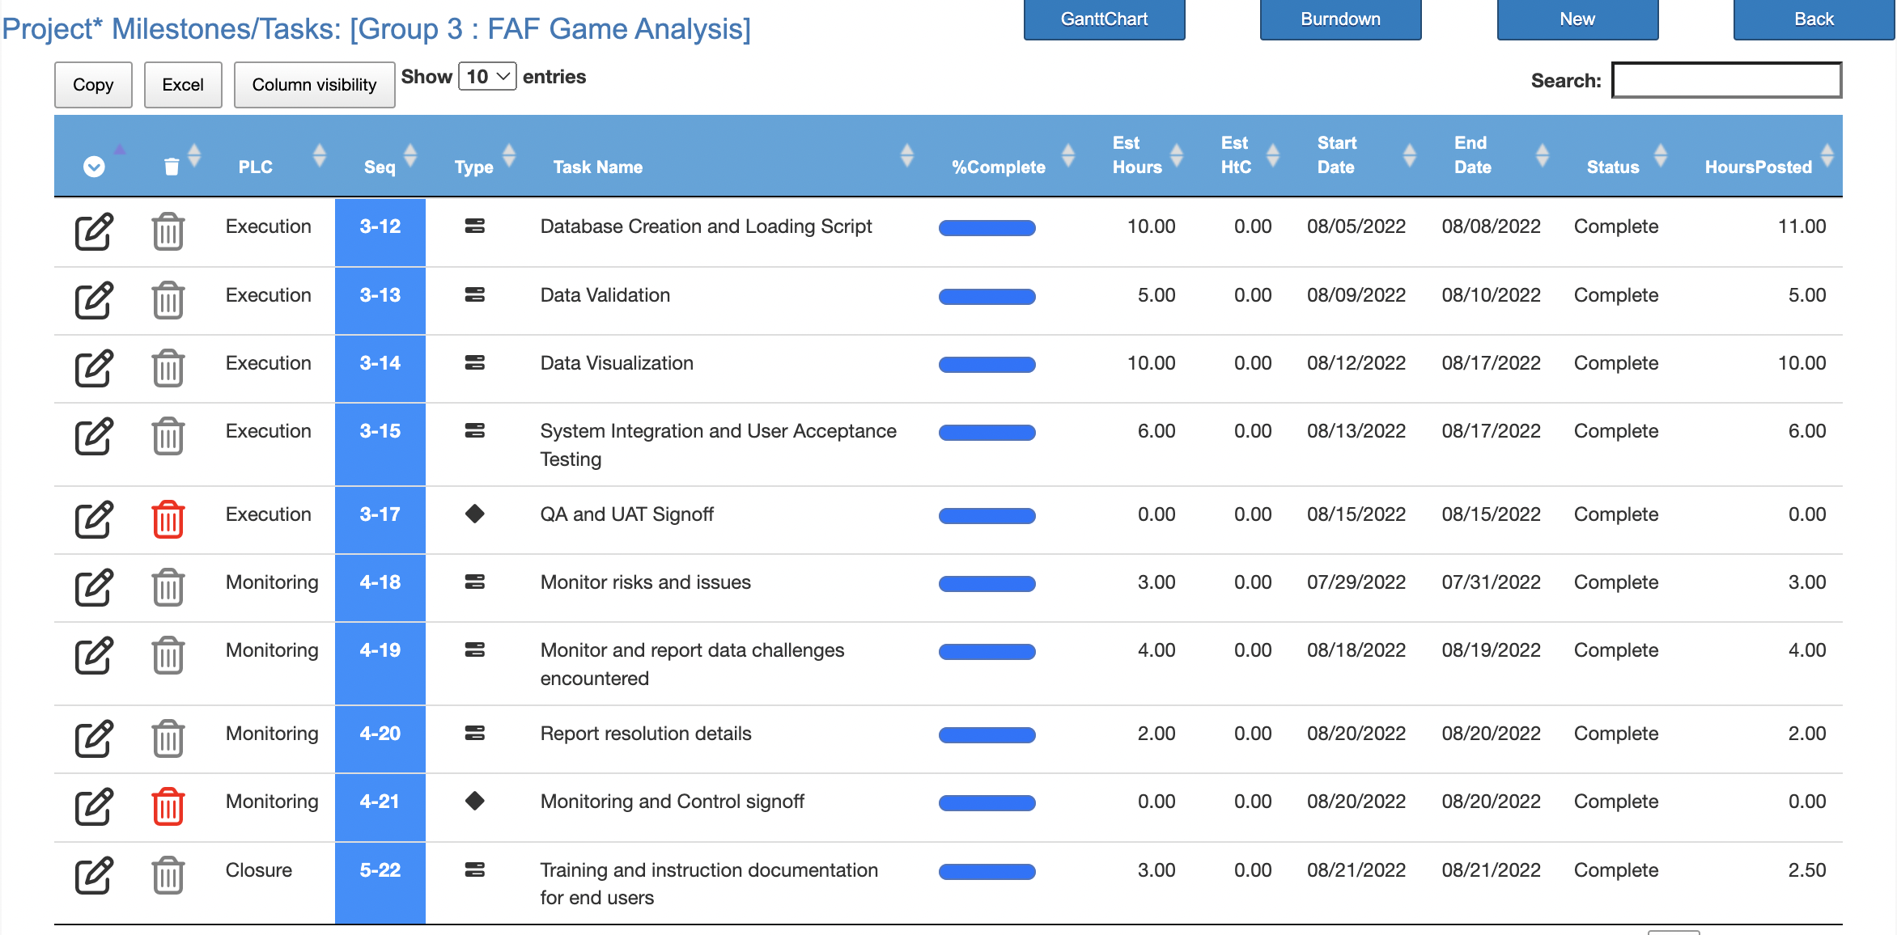
Tasks/Milestones

Slide 48
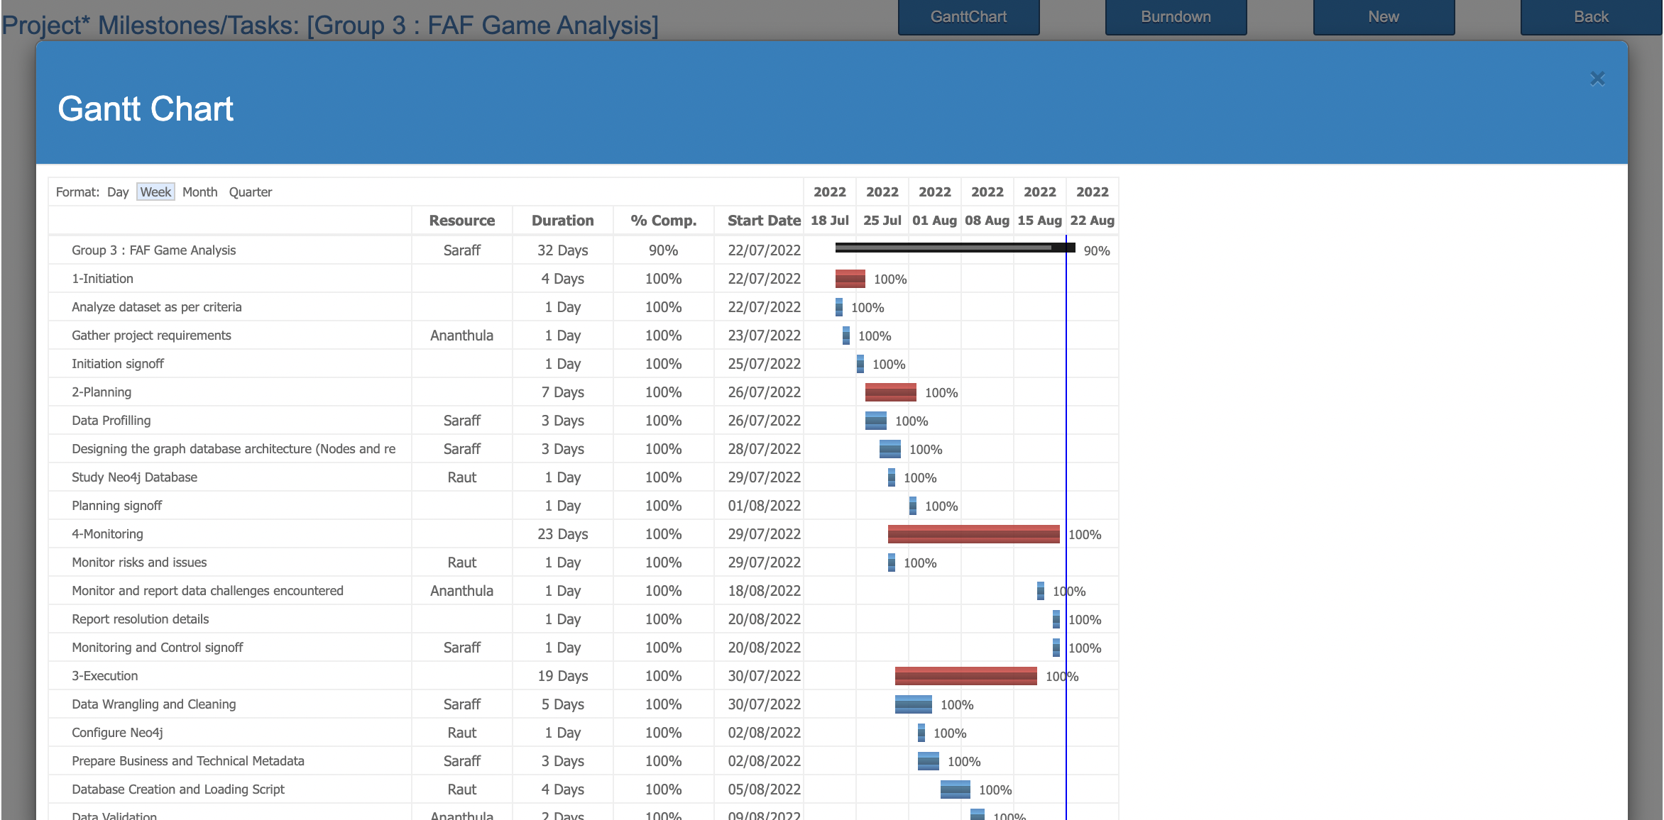
Gantt Chart

Slide 49

Gantt Chart

Slide 50
THANK YOU

